Slide 1

Safeguarding Belize's Intangible Cultural Heritage through Food
A Grant Funded Project of the UNESCO Intangible Cultural Heritage International Assistance & NICH
Rolando Cocom, Director of NICH-ISCR
2 October 2024

Slide 2

Why Food?
Foster
Foster respect and appreciation: Food serves as a bridge between cultures, encouraging understanding and appreciation of Belize's diverse ethnic groups.
Build on
Build on existing efforts: While cultural groups have undertaken ICH food-related programs, more work is needed to create a comprehensive inventory and safeguard these practices.
Understand
Understand ICH's role in disaster risk resilience: Food practices are essential for survival, enabling other ICH elements like festivals, language, rituals, and beliefs to thrive.
Promote
Promote sustainable development: Food heritage supports sustainable livelihoods and contributes to the well-being of communities.

Slide 3
Introduction
UNESCO's International Assistance for ICH offers financial and technical support to countries to safeguard their intangible cultural heritage, such as traditions, rituals and social practices.
This project seeks international assistance from UNESCO to safeguard Belize's living heritage by empowering cultural officers and communities to inventory and safeguard food traditions.

Slide 4

Project Objectives
Capacity Building:
National and District-level workshops
Train 150 cultural officers and community reps
Inventory Creation:
Documentation of 80 food practices
Recipes, techniques, rituals, stories
Living Heritage Network:
Strengthened and expanded
Active participation in ICH safeguarding
Awareness Raising:
Promotion of food heritage's importance
Education engagement in traditional and new media

Slide 5
Request approved
Objective: Strengthen community capacity to document and safeguard Belize’s food heritage.
Duration: 24 months to start in March 2025
Project Budget: US$159,037
UNESCO Approved: US$98,600
Belize Contribution: US$60,437

Slide 6
Belize contribution
Belize listed contribution: US$ 60,437
In-kind contribution: US$ 53,095
  ISCR Staff
  MoB-HoCs Staff
  Workshop and meeting venues
Listed financial contribution: US$ 7,342
  AV Equipment: 3482.00
  Website Maintenance: 2000
  External auditor: 1860.00 ($2140 from UNESCO; may require more)
Unlisted NICH strategic financial contribution for subsistence, vehicle and fuel.

Slide 7
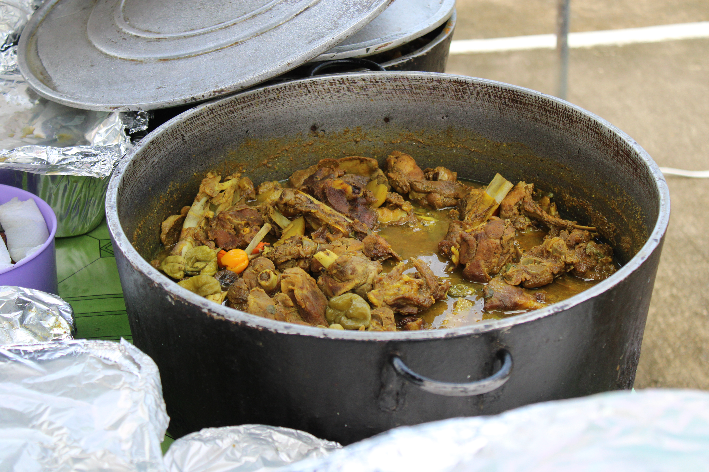
Key Assumptions
Capacity Building will build the Belize Living Heritage Network
Living Heritage Network will contribute to Belize’s Food ICH Inventory
Belize Food Inventory will foster Awareness and Resilience of Belizeans

Slide 8
Role of Communities &
Living Heritage Network
Identify & Prioritize: Communities will identify one community rep. per district, who along with a cultural worker of the House of Culture/Town Council will attend a national training
Plan Development: The representatives from the national workshop will host district level training and facilitate district level inventory exercises
Consent: They will be asked to give free, prior, and informed consent before any activities start.
Empowerment: They are empowered to take ownership and build skills for ICH safeguarding.
Implementation: They participate in implementing and evaluating safeguarding measures.
Sustainability: Assistance contributes to the long-term sustainability of their ICH efforts.
Emphasis: Balanced gender representation and intergenerational dialogue.

Slide 9
Expected Results
Short-term: Capacity building, public awareness, and documentation.
  Strengthened national and local capacity on safeguarding initiatives
  Public educational videos promoting Belize’s foodways
  Comprehensive online and offline inventory of 80 food heritage practices
Long-term: Enhanced cultural pride, sustainable development, and disaster resilience.
  After Project: Continued use of ICH Field Kits for future inventories
  Inventory: Digital platform (belizelivingheritage.org) as a long-term resource
  Community Empowerment: Strengthened ICH Network for ongoing collaboration

Slide 10
Conclusion
Key Message: The project will safeguard Belize's cultural food heritage while promoting sustainable development and resilience.
Context: The project was designed based on the Banquitas Action Plan, Maya Centre Declaration and in consultation with national cultural organizations and Belize’s Living Heritage Network
Next Steps: Promote project, finalize funding and initiate the national sensitization campaign.

Slide 11
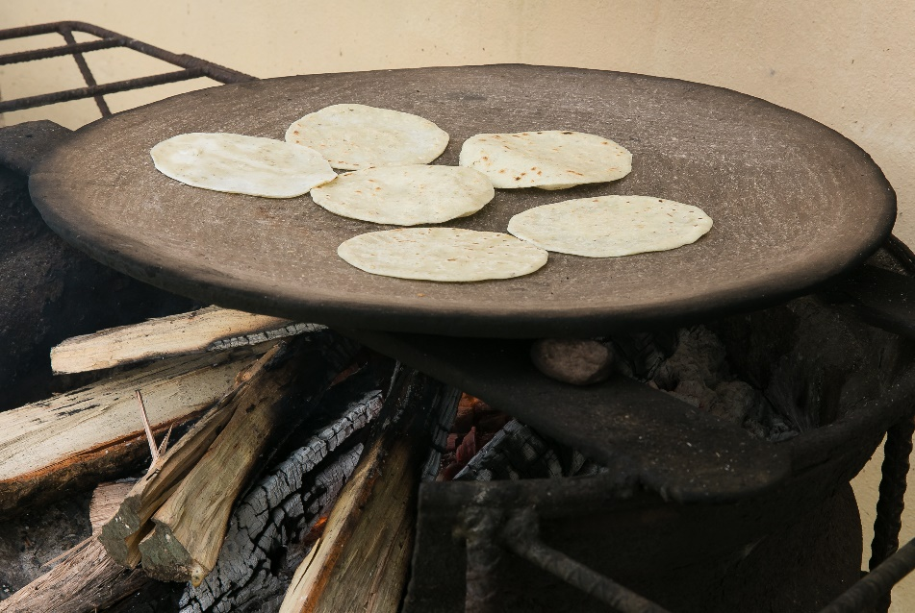

End, contact us:
Belizelivingheritage.org
Livingheritageofficer@nichbelize.org
Rolando.cocom@nichbelize.org

